Slide 1


Athens Digital Glossa Chronos
Retranslations Across Millennia: A Diachronic Contrastive Corpus
Nikolaos Lavidas, Kiki Nikiforidou, Theodoros Michalareas, Vassilios Symeonidis, Sofia Chionidi, Anastasia Tsiropina, Eleni Plakoutsi, Evangelos Argyropoulos, Vassiliki Geka
National and Kapodistrian University of Athens

Slide 2
SECTION 01
The Project Vision
Why AthDGC Matters

Slide 3
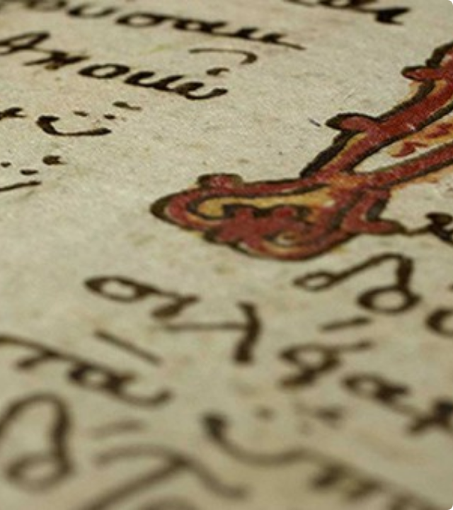

Our Mission
AthDGC investigates how translation acts as a vehicle for language change over 3,000 years.
We are building the first unified, digitally annotated corpus of Greek retranslations and their Germanic counterparts.

Slide 4

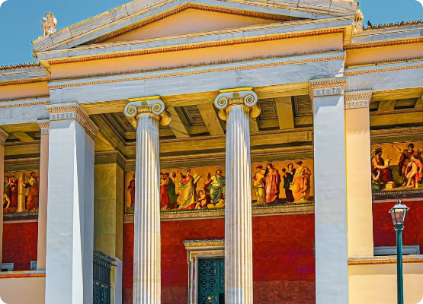
The Research Team
The project is driven by a specialized team at NKUA, combining expertise in Linguistics.
•
Nikolaos Lavidas, Kiki Nikiforidou
•
Theodoros Michalareas, Vassilios Symeonidis
•
Sofia Chionidi, Anastasia Tsiropina
•
Eleni Plakoutsi, Evangelos Argyropoulos
•
Vassiliki Geka

Slide 5
SECTION 02
Theoretical Framework
Diachronic Linguistics in AthDGC

Slide 6

AthDGC's Diachronic Approach
We do not view language as static. AthDGC specifically targets Diachronic Syntax.
•
We track changes across continuous timelines (8th c. BC – 20th c. AD).
•
We focus on Valency: The changing number and type of arguments a verb requires.

Slide 7


Language Contact Through Translation
The "Laboratory"
The Mechanism
AthDGC treats the translator's mind as a lab where two languages meet and influence each other.
We study how the source text (e.g., Ancient Greek) forces structural changes in the target (e.g., Gothic).

Slide 8

"Shining Through" in AthDGC Texts
Our corpus specifically looks for "Shining Through": where the source language structure remains visible in the translation.
•
In Bible Translations: Sacred texts are often translated literally ("Word for Word").
•
Result: Greek syntax is often imported directly into Latin, Gothic, and English.

Slide 9


Tracking Analyticity
The major trend AthDGC quantifies is the shift from Synthetic to Analytic structures.
From Synthetic
To Analytic
Rich Case Morphology (Ancient Greek / Old English)
Prepositions & Rigid Word Order (Modern Greek / English)

Slide 10
Grammaticalization
AthDGC tracks specific paths of grammaticalization within our texts.
Specific Case: We track the verb thélō ('to want') in Byzantine texts as it slowly loses its meaning to become the future marker tha.
This allows us to date exactly when a lexical word becomes a grammatical tool.

Slide 11
SECTION 03
The AthDGC Corpus
The Texts We Analyze

Slide 12

Criteria for Text Selection
We did not choose texts randomly. For AthDGC, texts must be:
•
Continuous: Retranslated repeatedly over centuries.
•
Influential: High-register texts that impact the standard language.
•
Parallel: Available in both Greek and Germanic varieties.

Slide 13
The Greek Corpus
Our Greek data spans the entire history of the language.
•
Classical: Homeric Epics (8th c. BC).
•
Koine: The New Testament (1st c. AD).
•
Byzantine: Chronicles (Sphrantzes).
•
Modern: 20th c. Vernacular Translations.

Slide 14


Why the New Testament?
Constant Variable
The Backbone
It acts as a "constant variable"—the meaning remains the same, so any change in wording reflects a change in grammar, not content.
The NT is the backbone of AthDGC because it is the most translated text in history.

Slide 15






The Germanic Corpus
Gothic
Old English
Modern English
Wulfila's Bible (4th c. AD)
Ælfric's Homilies (10th c. AD)
King James (17th c. AD)

Slide 16
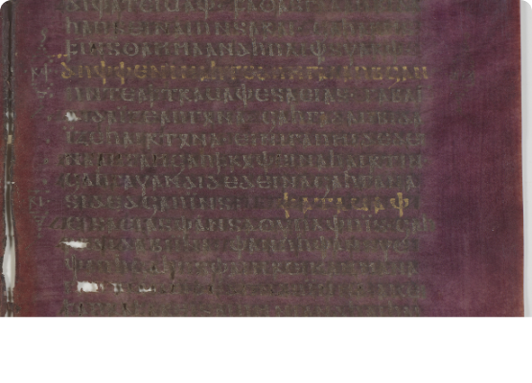
Gothic: The Critical Link
Wulfila's Gothic translation is the earliest Germanic text of substantial length.
It is a direct translation from Greek, often preserving Greek word order and case usage that disappeared in later Germanic.

Slide 17
SECTION 04
Methodology
How We Annotate & Analyze

Slide 18


The PROIEL Framework
Standardization
Compatibility
AthDGC adopts the PROIEL guidelines (Pragmatic Resources in Old Indo-European Languages) to ensure international compatibility (Oslo, Oxford).
This allows our data to be merged with other global historical treebanks, creating a massive unified resource.

Slide 19
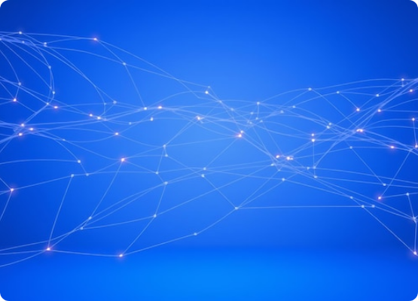
Dependency Grammar
We use Dependency Grammar because it handles the free word order of Ancient Greek perfectly.
Instead of linear trees, we map non-linear relationships (Head → Dependent) regardless of position.

Slide 20






Annotation Workflow
2. Morph-Tagging
3. Parsing
1. Tokenization
Assigning Case, Gender, Number, Tense to every word.
Manually connecting words to define syntactic roles (Subject, Object).
Splitting continuous text into individual words/tokens.

Slide 21
Methodology Challenge: Null Subjects
The Problem
The Solution
Greek is a "Pro-Drop" language (subjects are omitted). Example: "Lego" means "I speak" (No "I").
We insert "empty nodes" in the syntax tree to represent these implied subjects, preserving valency counts.

Slide 22
SECTION 05
Case Studies
Evidence from the Corpus

Slide 23


Intralingual Retranslation (Matt 6:11)
Ancient
Modern
dòs hēmīn sēmeron
dōse mas sēmera
Give us.DAT today
Give us.GEN/ACC today

Slide 24

Interlingual Retranslation (John 1:1)
Result
"In the beginning" across languages:
Modern English: In the beginning (Prepositional Phrase)
•
Greek: En archē (Prep + Dative)
•
Latin: In principio (Prep + Ablative)
This chain shows how Prepositional Phrases were calcqued (copied) across European languages.
•
Old English: On anginne (Prep + Dative)

Slide 25
The Evolution of Voice
Ancient System
Modern System
Three distinct voices: Active, Middle, Passive
Two distinct voices: Active, Medio-Passive

Slide 26
SECTION 06
Challenges
Hurdles in Digital Philology

Slide 27
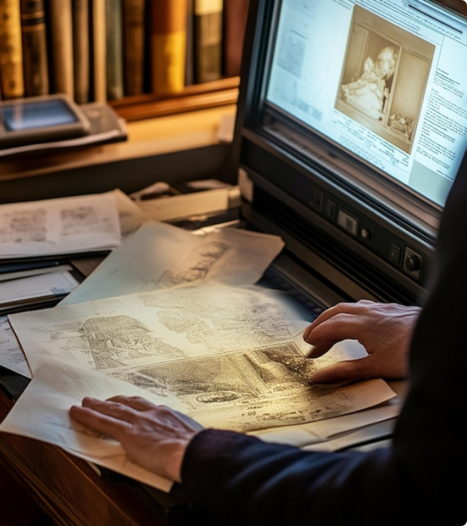
Digitization Challenges
Historical texts are messy. We face:
•
Orthography: Spelling was not standardized until recently.
•
Characters: Archaic letters (digamma, thorn, eth) confuse standard OCR.
Solution: We use custom-trained Transkribus models for manuscript recognition.

Slide 28
Challenge: Automatic Parsing
The Failure
The Fix
Modern NLP parsers fail on Medieval Greek (Accuracy < 42%) because they are trained on Modern Greek syntax.
We are developing specialized algorithms tailored specifically to historical varieties to improve accuracy.

Slide 29
Challenge: Modern Particles
Tagset Expansion
New Elements
We extended the PROIEL tagset to include these new categories while maintaining backward compatibility.
Modern Greek uses particles (tha, na, as) that did not exist in Ancient Greek.

Slide 30
SECTION 07
Impact & Future
What AthDGC Delivers

Slide 31

The Diachronic Valency Lexicon
The crown jewel of AthDGC is the Valency Lexicon, a searchable online database linking raw frequency counts with specific textual examples.
Future Aims: We aim to provide detailed genealogical information and data on borrowing/language contact for each entry.

Slide 32
Application: Education
AthDGC resources aim at revolutionizing how Ancient Greek is taught.
•
Data-Driven Learning: Students can see real usage stats, not just textbook rules.
•
Vocabulary: Frequency lists based on actual historical strata.

Slide 33
Application: Digital Philology
Ground Truth
Automation
Our annotated corpus serves as the "Ground Truth" for optimizing computational algorithms.
It enables improved Automatic Glossing for digital libraries and refined computational analysis.

Slide 34

Phase II: Expanding Horizons
We plan to expand beyond Greek and Germanic to include:
•
Slavic: Old Church Slavonic.
•
Celtic: Old Irish.
•
Indo-Iranian: Sanskrit.

Slide 35



Commitment to Open Science
Open Access
Community
All data, trees, and tools are released freely on GitHub/GitLab.
We invite global collaboration to refine and expand the corpus.

Slide 36
Final Conclusion
The Evidence
The Bridge
It proves that translation drives change and quantifies the massive historical drift to analyticity.
It bridges the gap between Philology, Diachronic Linguistics, and Computer Science.

Slide 37
Questions?
Athens Digital Glossa Chronos
Thank you for your attention.

Slide 38
Selected References (1)
•
Nikiforidou, K. (1991). The meanings of the genitive: A case study in semantic structure. Cognitive Linguistics.
•
Eckhoff, H. M., et al. (2018). The PROIEL treebank family. Language Resources and Evaluation.
•
Sitaridou, I. (2014). Word order. In G. K. Giannakis (Ed.), Encyclopedia of Ancient Greek Language.

Slide 39
Selected References (2)
•
Tesnière, L. (1959). Éléments de syntaxe structurale.
•
Lavidas, N. (2021). The Diachrony of Written Language Contact. Brill.
•
Trips, C. & Stein, A. (2019). Contact-induced changes in the argument structure of Middle English verbs.
•
Levin, B. (1993). English Verb Classes and Alternations.

Slide 40
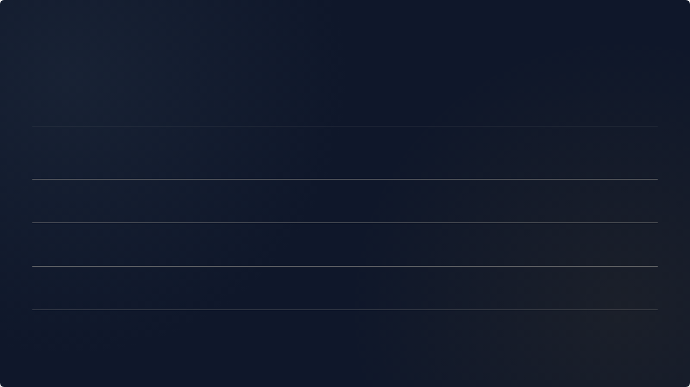






Image Sources
https://danielbwallace.com/wp-content/uploads/2015/09/cropped-img_bg_huge.jpg
Source: danielbwallace.com
https://external-preview.redd.it/national-and-kapodistrian-university-of-athens-building-a-v0-PNk16ZF-QRapAvMKGTUGcuS9jHrNj_xJeXRnffZqqOM.jpg?width=1080&crop=smart&auto=webp&s=85f3282e2b89bcf3c89a872193a64021165ae6bb
Source: www.reddit.com
https://img.freepik.com/premium-vector/abstract-hand-drawn-hourglass-time-clock-sand-doodle-concept-vector-design-outline-style_324137-6277.jpg
Source: www.freepik.com
https://media.istockphoto.com/id/517778587/photo/old-books-on-wooden-table.jpg?s=612x612&w=0&k=20&c=i0NIIzs1nWilgaao9wLa09AnYvqHDkwj4yIfbY7_lJ0=
Source: www.istockphoto.com
https://images.stockcake.com/public/d/a/2/da2b4f7f-be2d-458d-9a8a-2bf4f7b14b9f_large/ancient-library-interior-stockcake.jpg
Source: stockcake.com
https://upload.wikimedia.org/wikipedia/commons/3/31/Codex_Argenteus_page.jpg
Source: en.wikipedia.org

Slide 41
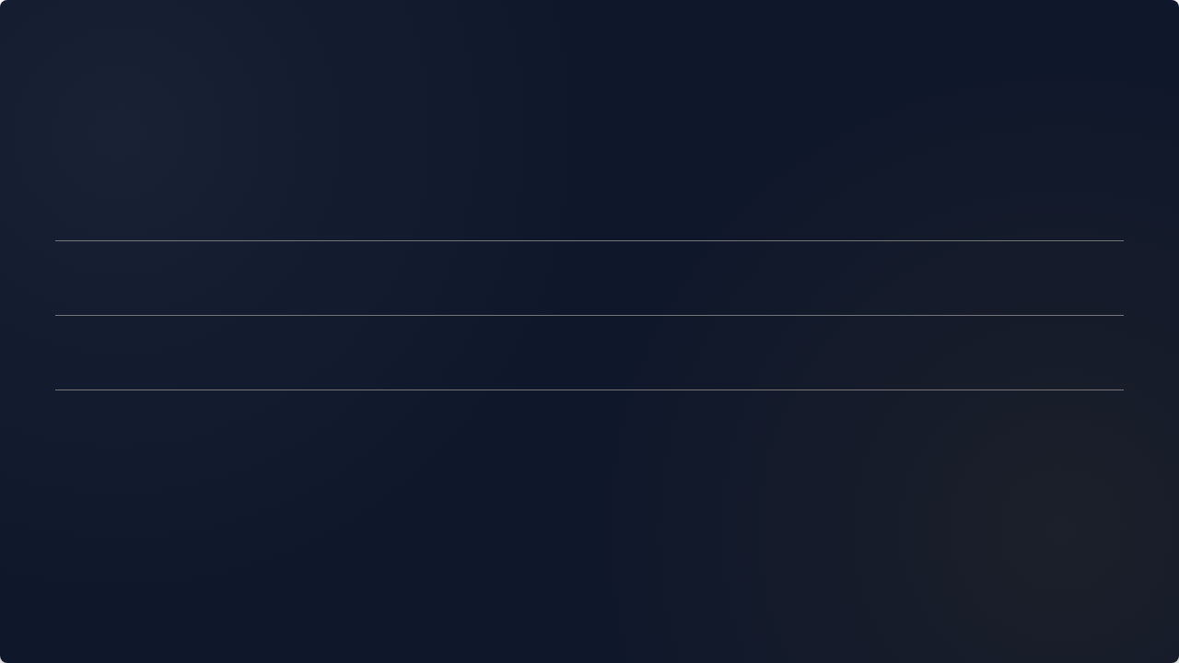




Image Sources
https://img.freepik.com/premium-photo/abstract-network-interconnected-lines-with-glowing-nodes-against-blue-background_1174990-198028.jpg
Source: www.freepik.com
https://img.freepik.com/premium-photo/person-digitizing-old-documents-with-highresolution-scanner_995578-31512.jpg
Source: www.freepik.com
https://www.christs.cam.ac.uk/sites/default/files/inline-images/Christ%27s%20College%2C%20Cambridge%20Old%20Library%203.jpg
Source: www.christs.cam.ac.uk
https://st.depositphotos.com/2627021/2997/i/950/depositphotos_29974017-stock-photo-connected-world-europe-asia.jpg
Source: depositphotos.com

